Slide 1
SMART IRRIGATION

Slide 2
INTRODUCTION
Smart irrigation systems can improve crop yields while saving water.
These systems use soil moisture sensors to determine the amount of moisture in the soil.
They release the flow of water through the irrigation pipes using a motor, only when the moisture levels go below a predefined threshold.
Smart irrigation systems also collect moisture level measurements on a server or in the cloud where the collected data can be analyzed to plan watering schedules.

Slide 3
Components Used: ESP 32 Wifi Module, Soil Moisture Sensor, Motor, LED
Software: Arduino IDE
Language Used: Embedded C
DataBase: Firebase, ThingSpeak
App FrameWork: Blynk App, MIT Inventor App, Streamlit WebApp

Slide 4
Hardware

Slide 5
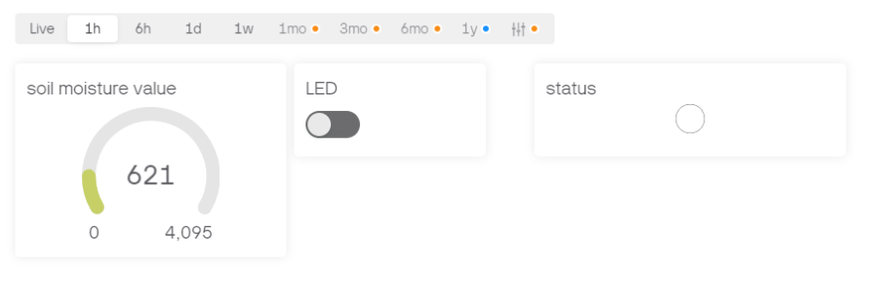
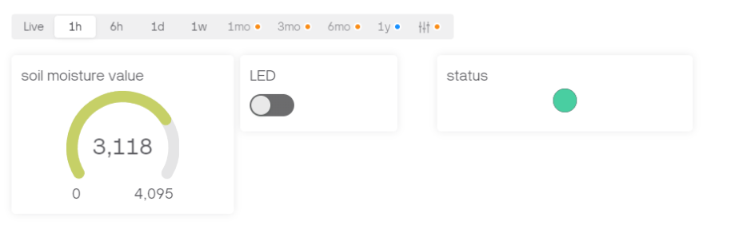
Blynk Dashboard

Slide 6
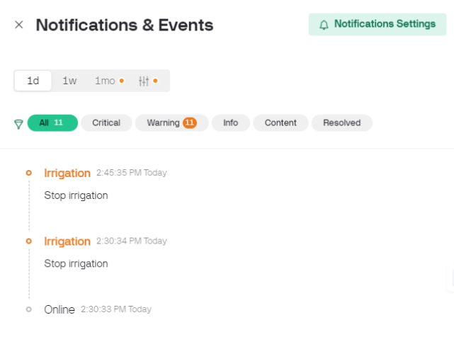
Blynk Dashboard

Slide 7
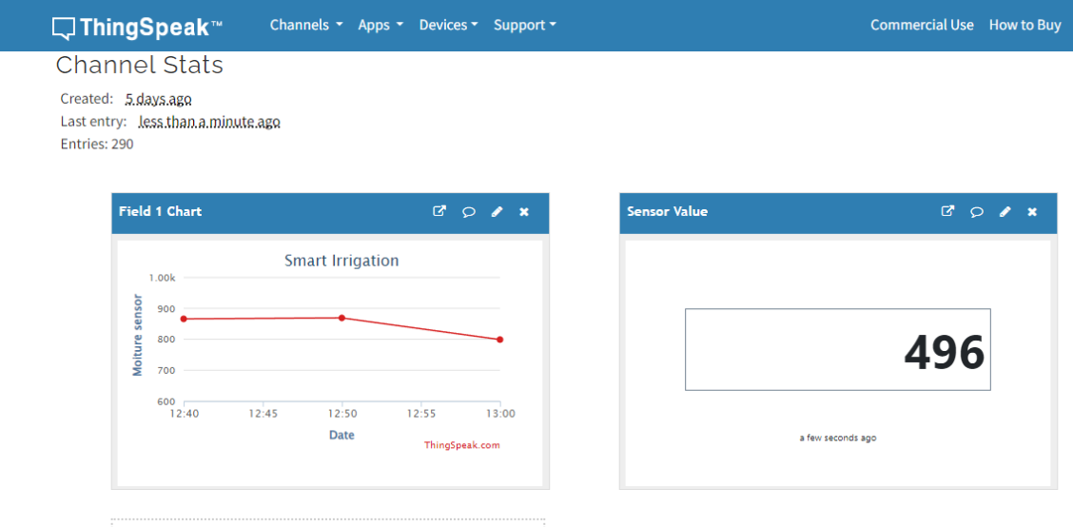
ThingSpeak

Slide 8
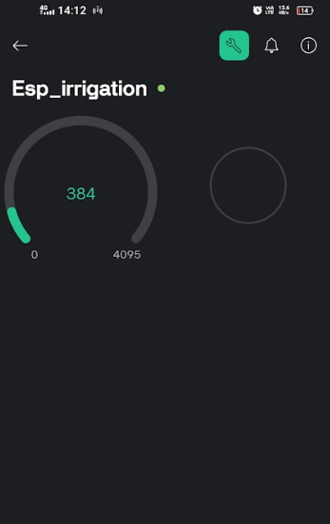
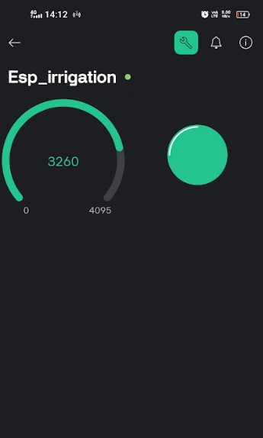
Blynk App

Slide 9
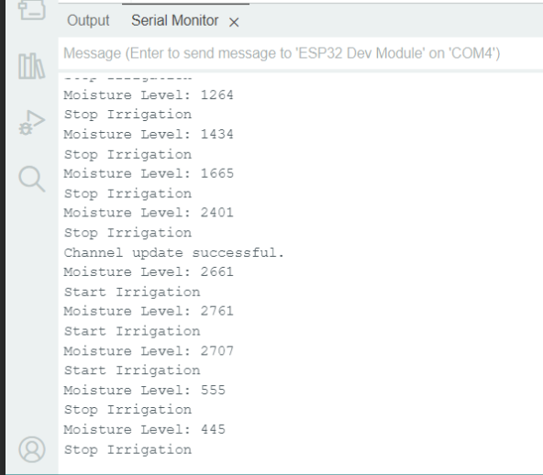
Arduino IDE

Slide 10
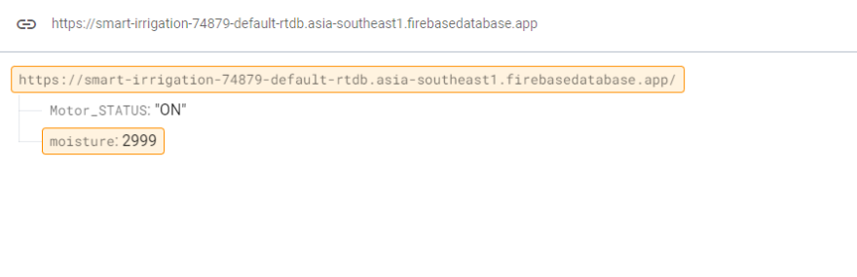
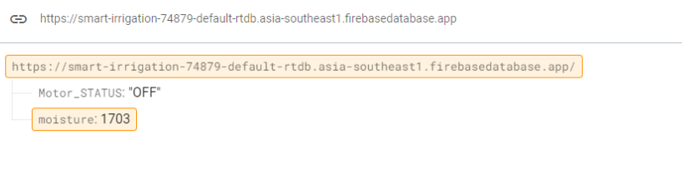
Firebase Database

Slide 11
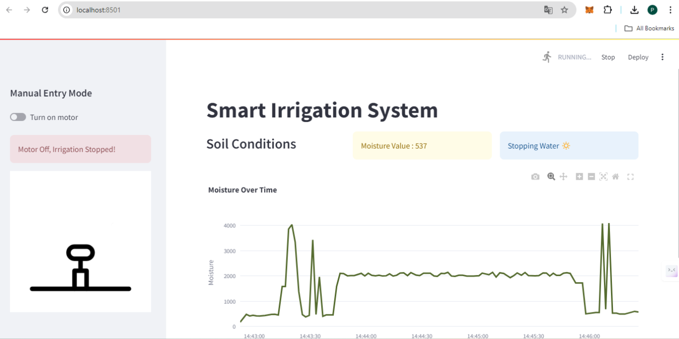
Streamlit Web App

Slide 12
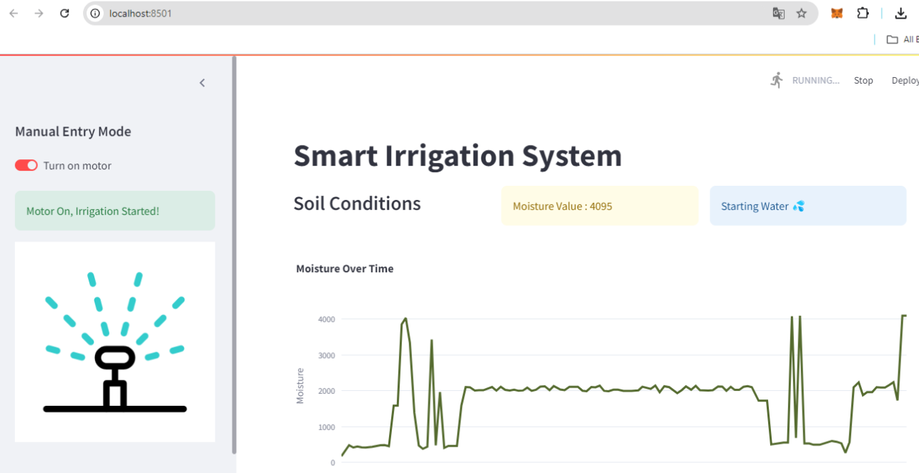
Streamlit Web App

Slide 13
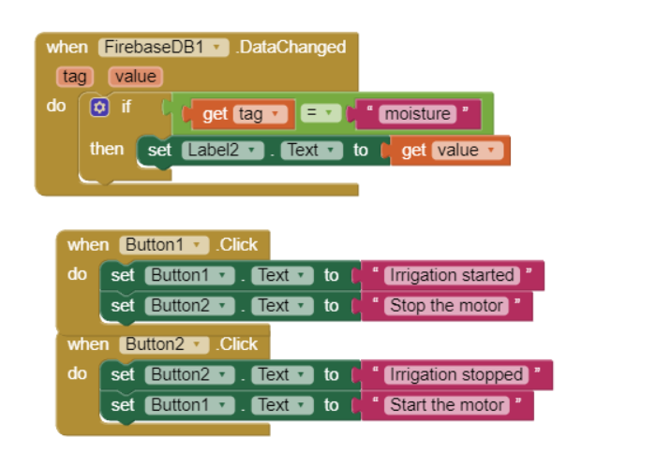
MIT INVENTOR APP

Slide 14
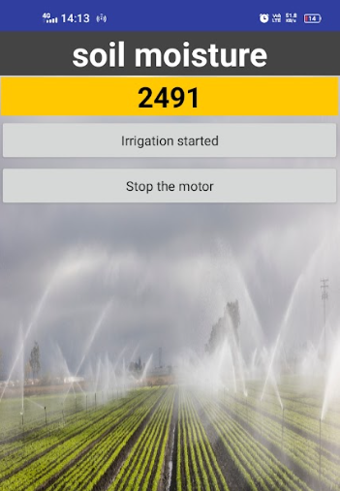
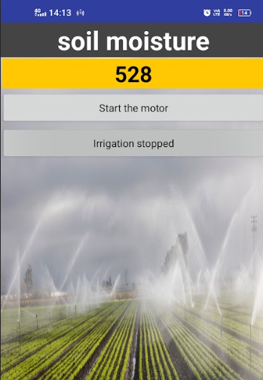
MIT INVENTOR APP

Slide 15
APPLICATIONS
Precision Agriculture: Smart irrigation helps farmers optimize water distribution by using sensors to measure soil moisture, weather conditions, and crop requirements. This reduces water waste, improves crop yields, and supports sustainable farming practices.
Water Conservation in Drought-Prone Areas: Smart irrigation is crucial in regions where water is scarce. By minimizing unnecessary water use, these systems help conserve water and maintain vegetation even in challenging environments.
Greenhouse Automation: Smart irrigation in greenhouses automates the watering process based on specific plant needs, creating an optimal growing environment by regulating humidity, temperature, and water delivery.

Slide 16
THANK YOU

